Slide 1
Building The Enchanted Land
Grady Booch
IBM Fellow & Chief Scientist for Software Engineering
Email: gbooch@us.ibm.com
Twitter: @grady_booch
Web: computingthehumanexperience.com
Notes:
Contemporary computers are formed of a few billion transistors, running at gigahertz clock rates and consuming several hundred watts of power; the human brain is formed of 100 billion neurons, running at 20 Hz and consuming 20 watts of power. Each form factors has its advantages: a computer can process enormous piles of data tirelessly and far more rapidly than any human; even an infant brain can make inferences about the world that no computer can even begin to approach. There is reason to believe that the mind is computable, and so we are driven to find ways to bridge the gap between the physicality of silicon and the exquisite wonder of the brain.

Slide 2


Slide 3
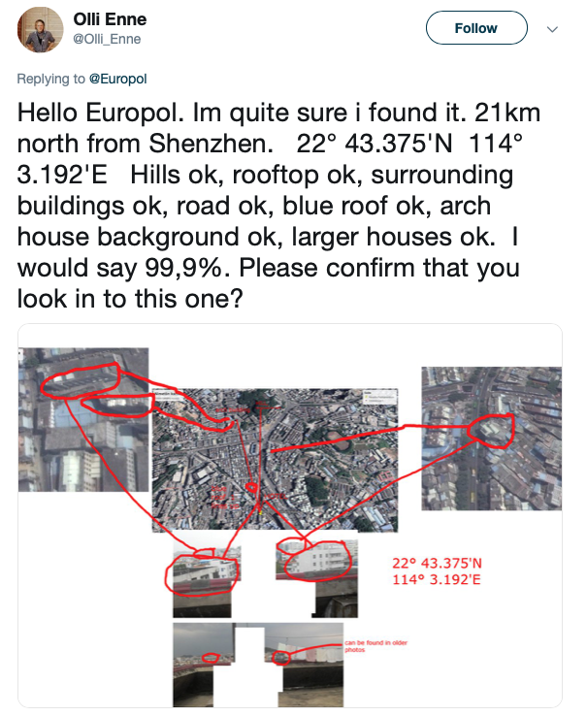

Slide 4



Slide 5
Identification of architectural styles
Matching styles to places
Identification of local topology
Matching topology to places
Identification of building features
Matching features to Google Earth data

Slide 6
This is a systems problem with AI components
Pattern matching
Geometric translation of 2D and 3D features
Search
Constraint resolution with probabilities of outcomes

Slide 7
Most of contemporary AI is about
Pattern matching of signals on the edge
Inductive reasoning
But not about
Decision making
Abductive reasoning

Slide 8
Contemporary AI is not all that modern
Many current architectures and algorithms are already a few decades old
But what’s different today
The accumulation of large bodies of tagged data
An abundance of computational power

Slide 9
AI is a software-intensive system that
Reasons
Learns
Anything less, then it’s not AI

Slide 10

Notes:
SNARC (Stochastic Neural Analog Reinforcement Calculator) 1951

Slide 11
http://www.datamation.com/data-center/artificial-intelligence-vs.-machine-learning-whats-the-difference.html

Slide 12
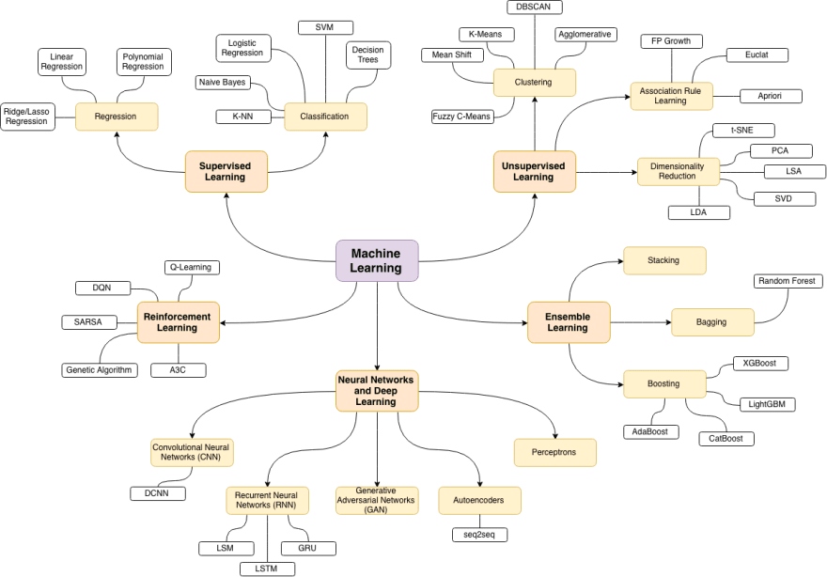
https://dev.to/trekhleb/machine-learning-in-matlaboctave-1lg

Slide 13
Frank Chen http://a16z.com/2016/06/10/ai-deep-learning-machines/

Slide 14
Frank Chen http://a16z.com/2016/06/10/ai-deep-learning-machines/

Slide 15
Frank Chen http://a16z.com/2016/06/10/ai-deep-learning-machines/

Slide 16
“Deep learning has yielded numerous state of the art results, in domains such as speech recognition, image recognition, and language translation and plays a role in a wide swath of current AI applications.”
-- Gary Marcus
https://medium.com/@GaryMarcus/in-defense-of-skepticism-about-deep-learning-6e8bfd5ae0f1

Slide 17
“We need to reconceptualize [DL] not as a universal solvent, but simply as one tool among many, a power screwdriver in a world in which we also need hammers, wrenches, and pliers, not to mention chisels and drills, voltmeters, logic probes, and oscilloscopes.”
-- Gary Marcus
https://medium.com/@GaryMarcus/in-defense-of-skepticism-about-deep-learning-6e8bfd5ae0f1

Slide 18
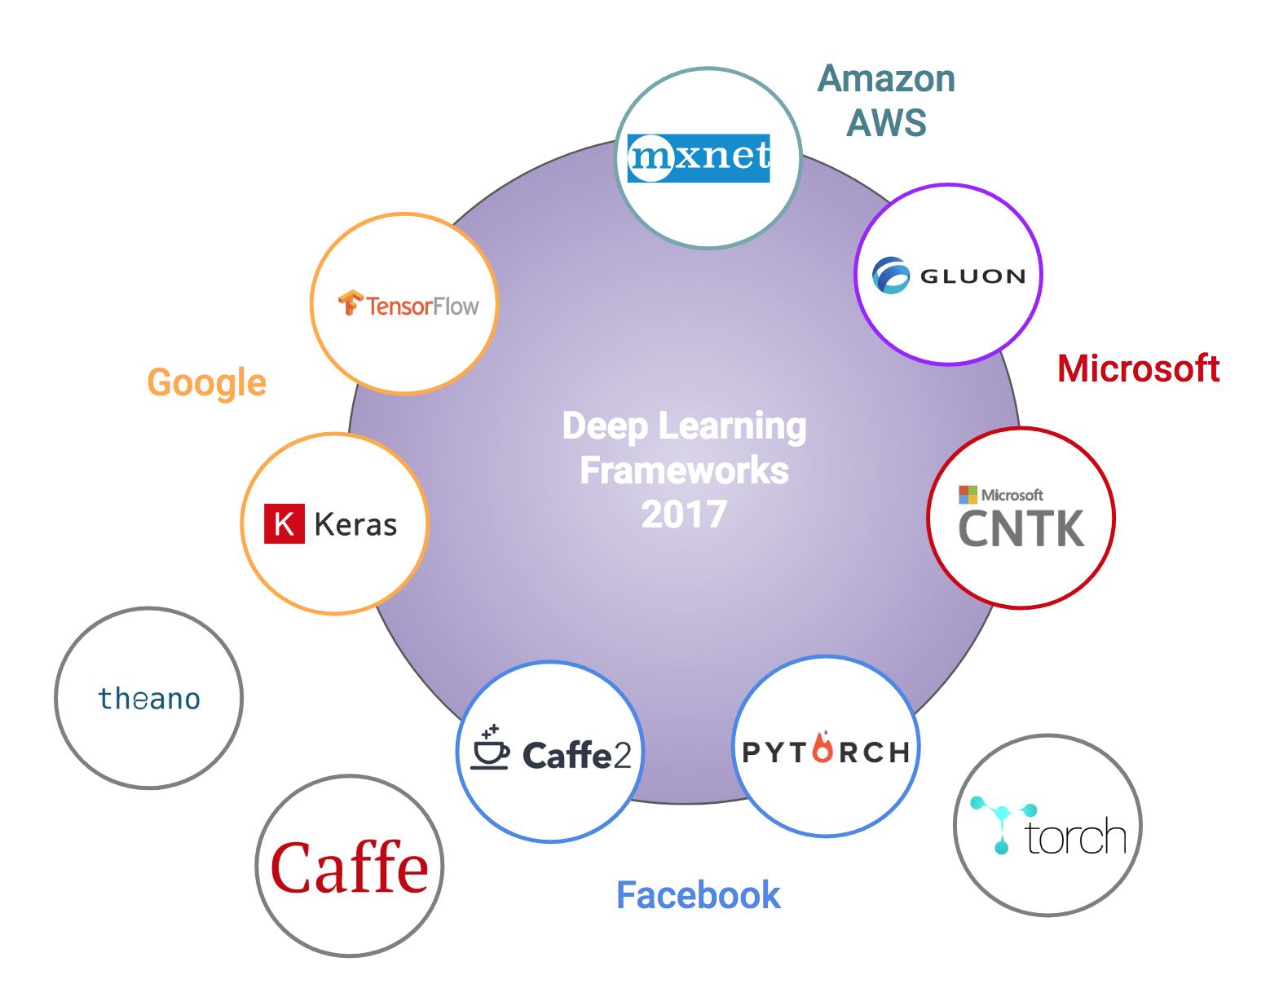

Slide 21
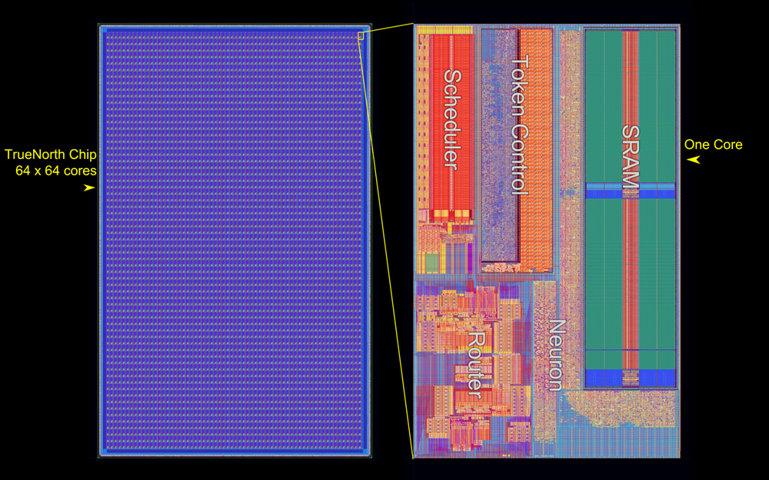
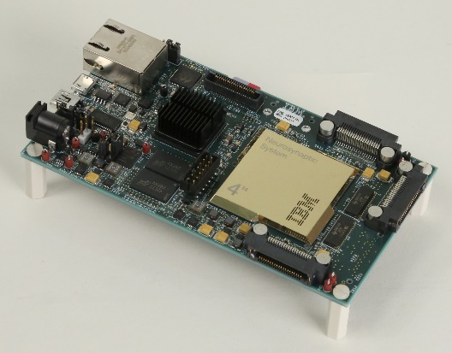
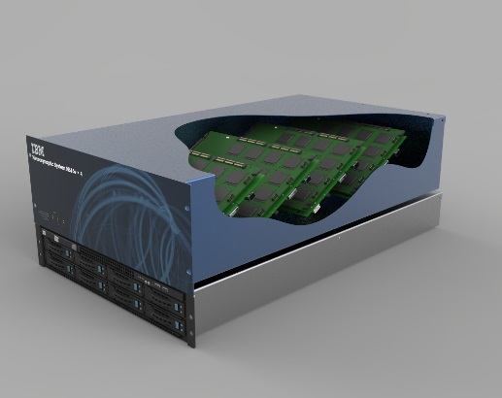
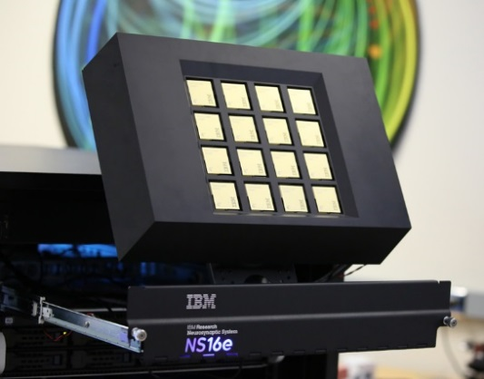



28nm LPP Process
10² neurons
10⁶ neurons
10⁷ neurons
~10⁸ neurons
~10⁹ neurons
2011
2015
2016
2017
2018

Slide 22
Notes:
NVIDIA Xavier, a system on a board consisting of Volta Tensor Core GPU, one eight-core ARM64 CPU, two NVDLA deep learning accelerators, processors for static images and video, constructed of 9 billion transistors delivering over 30 TOPS (trillion operations per second) of compute at only 30 watts of power.

Slide 23

Distributed Deep Learning
100s of servers with GPUs scale of the computational infrastructure enabled by IBM’s communication library for Distributed Deep Learning training
95% scaling efficiency achieved by IBM @ 256 P100 GPUs
+4% increase in image recognition accuracy over previous best result
Notes:
training vs inference
— many startups on inferencing on the edge
— true north focus on inferencing
— google focus on training
— lots of new things we can do if we infer on the edge…this is the cloud/edge pendulum

Slide 24




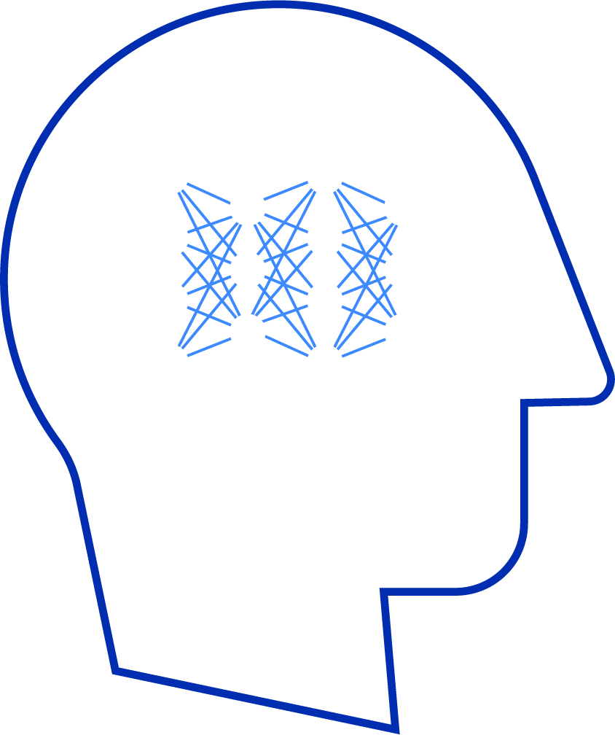
Beyond Exact Computing
Reduced Precision Computation
64 and 32 bit floating point arithmetic is overkill for DNN training and inference*
16 bit formats shown to be sufficient for wide array of Deep Learning tasks
Cores with 16 bit precision 4X smaller than cores with 32 bit precision
Approximate Computing
Trade numerical precision for computational efficiency
Algorithmic improvements to retain model accuracy
high
RESOLUTION
Reduced Precision Computation
low
Human Brain
Resolution needed to recognize the image
S. Gupta et al, Deep Learning with Limited Numerical Precision, ICML,’15
IBM Research / Khare ASMC / May 1, 2018 / © 2018 IBM Corporation
Notes:
need for less precision
— important simplifying assumption
— 32 bits is overkill; one can get by with 8 bits on the inference side
lots of the old vlsi tricks apply
— it’s about building systems

Slide 25
Computing
Software engineering
Formal methods
Economics
Methodologies
Architecture
Design
Programming
Human-computer interaction
Computer graphics
Computer graphics
Image processing
Information visualization
Mathematical foundations
Coding theory
Game theory
Graph theory
Mathematical logic
Number theory
Theory of computation
Automata theory
Computability theory
Computational complexity
Quantum computing
Programming languages
Compiler theory
Programming language pragmatics
Programming language theory
Formal semantics
Type theory
Algorithms/data structures
Algorithms
Data structures
Artificial Intelligence
Fundamentals
Automated reasoning
Computer vision
Natural language processing
Robotics
Artificial General Intelligence
Soft computing
Machine learning
Deep learning
Evolutionary computing
Scientific computing
Computational science
Numerical analysis
Symbolic computing
Computational physics
Computational chemistry
Computational biology
Computational neuroscience
Databases
Relational databases
Structured storage
Data mining
Computer architecture
Computer architecture
Operating systems
Concurrent, parallel, and distributed systems
Parallel computing
Concurrency
Distributed computing
Communication and security
Networking
Computer security
Cryptography
Meta
History
Social, moral, and ethical issues

Slide 26
Everything is a system
Everything is part of a larger system
Systems display antics; the total behavior of large systems cannot be predicted
A complex system cannot be "made" to work
A simple system, designed from scratch, sometimes works
Some complex systems actually work
In complex systems, malfunction and even total non-function may not be detectable for long periods, if ever
Colossal systems foster colossal errors
John Gall Systemantics

Slide 27
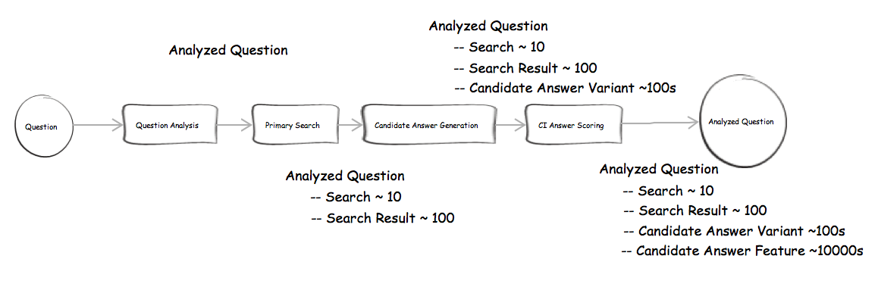

Slide 28
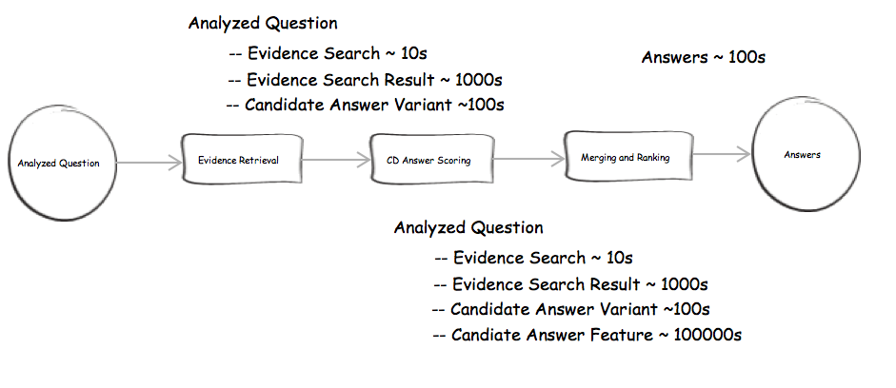

Slide 29
Notes:
AlphaGo is holonomic

Slide 30
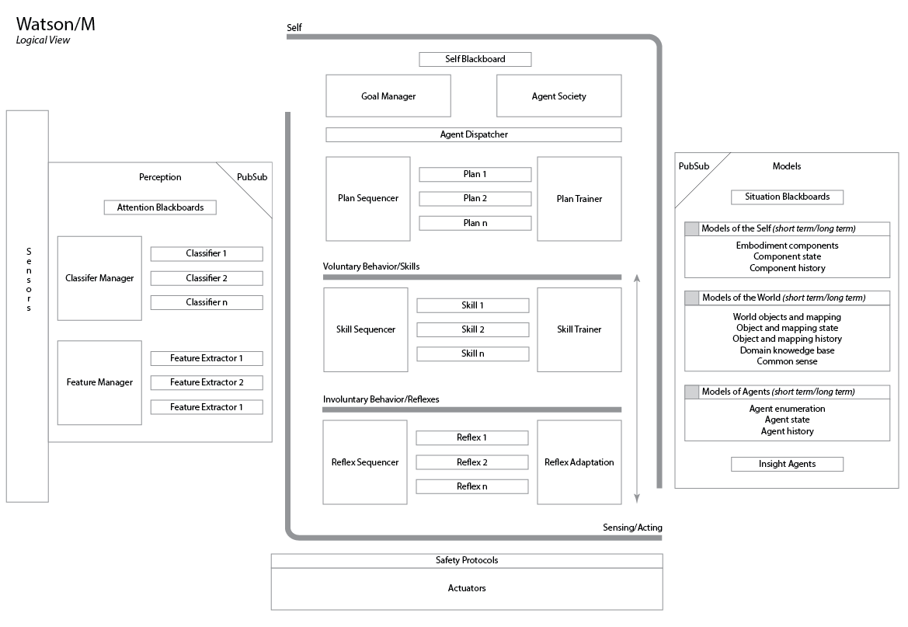

Slide 31


Slide 32
System
Cost
Schedule
Legal
Ethical
Safety
Reliability
Functionality
Evolution
Deployment
Development
Complexity
Context
Mission
Compatibility
Performance
Security

Slide 33
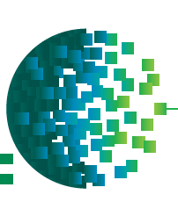


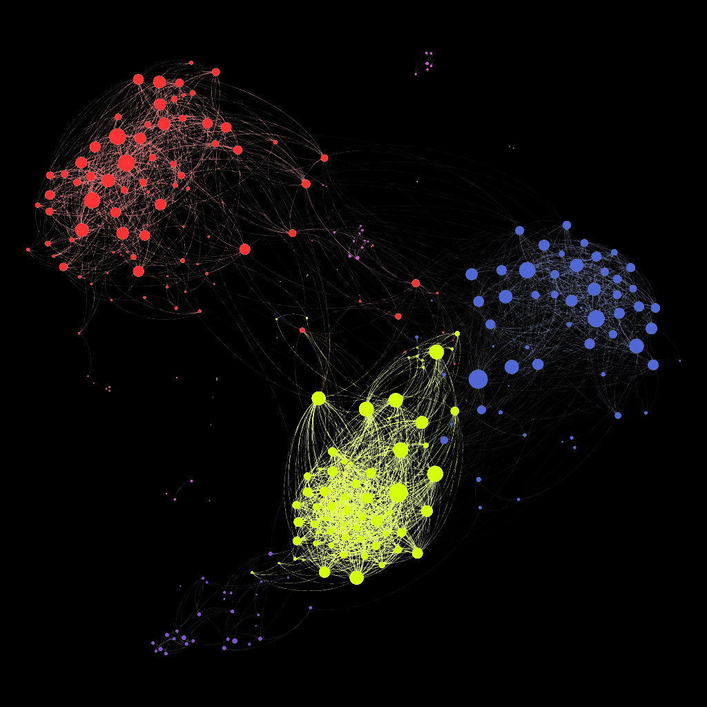


Physics
Algorithm
Architecture
Organization
Economics
Human

Slide 34





Slide 35
Crisp abstractions
Clear separation of concerns
Balanced distribution of responsibilities
Simplicity
Grow a system through the iterative and incremental release of an executable architecture

Slide 36
There is work to be done
Orchestrating hybrid symbolic, connectionist, and quantum models of computation
The architectural pendulum
The edge/cloud pendulum
Scale, in the presence of untrusted components, legacy of considerable inertia, and the general public

Slide 37
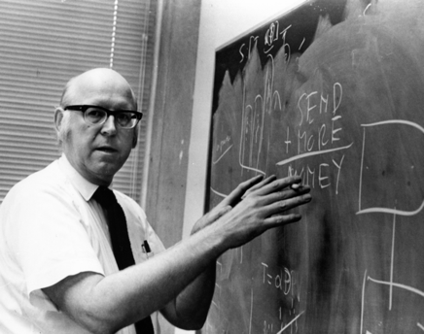
Computer technology offers the possibility of incorporating intelligent behavior in all the nooks and crannies of our world. With it, we could build an enchanted land.
Allen Newell

Slide 38
Grady Booch
IBM Fellow & Chief Scientist for Software Engineering
Email: gbooch@us.ibm.com
Twitter: @grady_booch
Web: computingthehumanexperience.com

